Slide 1
Security testing of web application
Deploying IT Infrastructure Solutions 2013
Margus Ernits
Tallinn
27.03.2013

Slide 2
Current Situation
Study Information System is used ~20000 users from ~10 different higher education institutions
Development is done by Estonian IT College IT development team with help of several external development companies
SIS is actively developed and not all new features are intensively tested

Slide 3
The Problem
Security should be tested regular basis but development team cannot do all testing
More testers will find more bugs

Slide 4



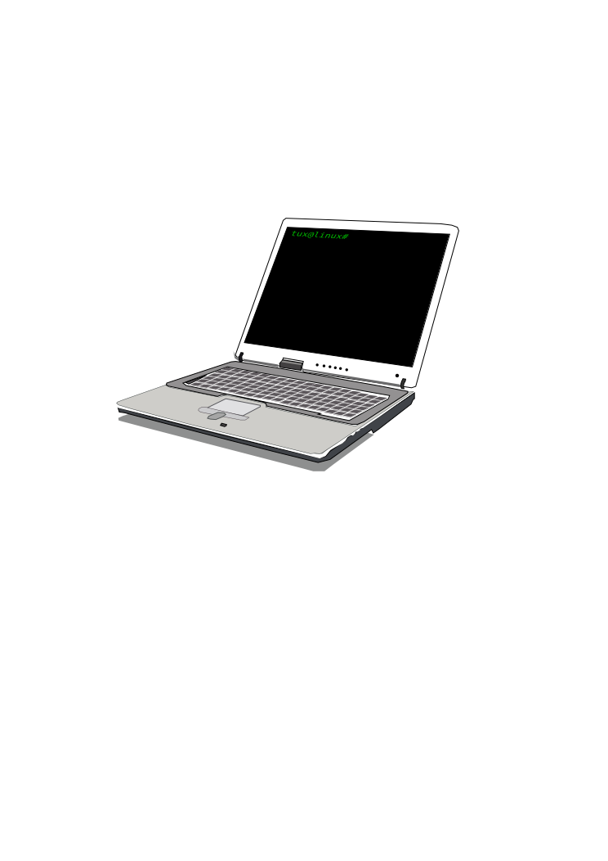
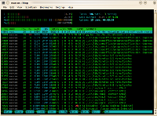
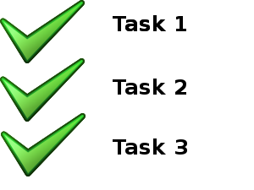

The Distance Laboratory
Configured virtual
infrastructure for
each student
Student uses
Sometimes
Several virtual
Machines are used
in practical class
Student does practical work
Student sees screen of virtual lab
Kontrolli
süsteem
Interaktiivne tagasiside
ja nõuanded

Slide 5
Distance Laboratory

Slide 6

Exploits of a Mom...can be stopped
Source: Exploits of a Mom http://xkcd.com/327/

